Slide 1
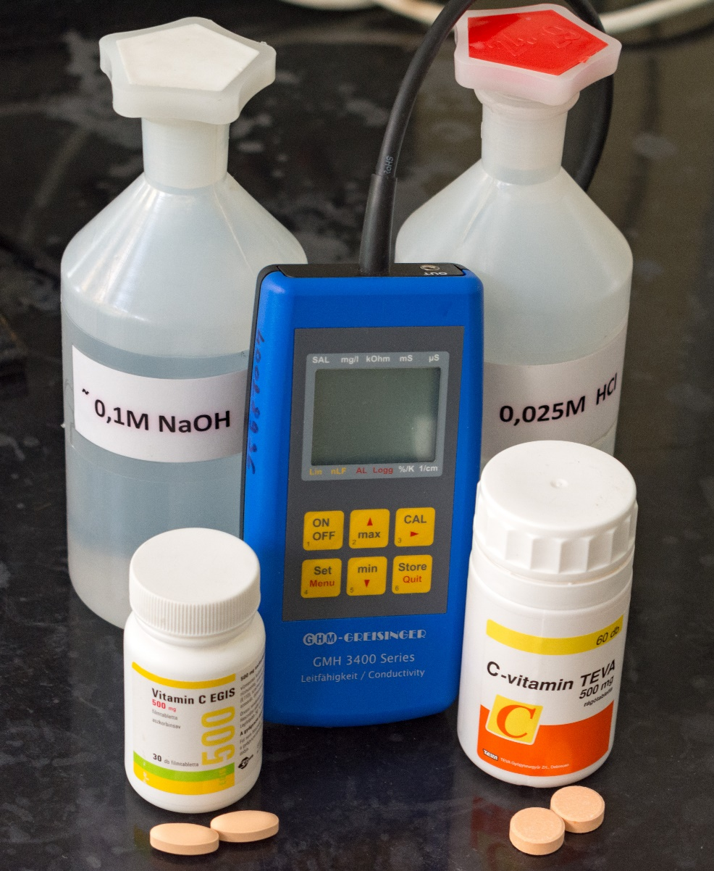
Conductometry
eLearning course
made by:
Dr. Virag Kiss
kiss.virag@science.unideb.hu

Slide 2
Theoretical background / repetition
I.
purpose of the chemical analysis: quantitative
qualitative
steps of the analysis:
defining the problem
method selection
sampling, storage
sample preparation, processing
measurement
calculations, evaluation
comparison of the obtained results with literature data / standard

Slide 3
Theoretical background / repetition
II.
instrumental analytical chemistry methods:
spectroscopic methods (NMR, UV, IR, X-ray, atomic spectroscopy, etc.)
separation techniques (chromatographic, electrophoretic methods, etc.)
electrochemical methods (conductometry, potentiometry, voltammetry, etc.)
coupled techniques (CE-MS, HPLC-UV etc.)
electrolyte solutions are measured during conductometric measurements.
material
isulators
conductors
second-order (ion) conductors
first-order (electron) conductors
electrolyte
weak electrolytes
strong electrolyte

Slide 4
Theoretical background / repetition
III.
What and how do we measure with a conductometer?
1. a small alternating current is applied to the electrode
2. two poles are formed on the electrode: negative and positive
(electrolysis would occur by using direct current)
3. the ions in the solution “migrate” to the opposite pole
4. the conductometer measures the resistance between these two poles
The cell constant is a geometric factor specific to the measuring electrode for comparing non-standard cells.
Conductometry is not a selective method, the conductance of total ions in the solution is measured.
When can we follow a change in conductance?
if the concentration of total ions changes
if the concentration of total ions does not change but ions with different mobilities are „exchanged”

Slide 5
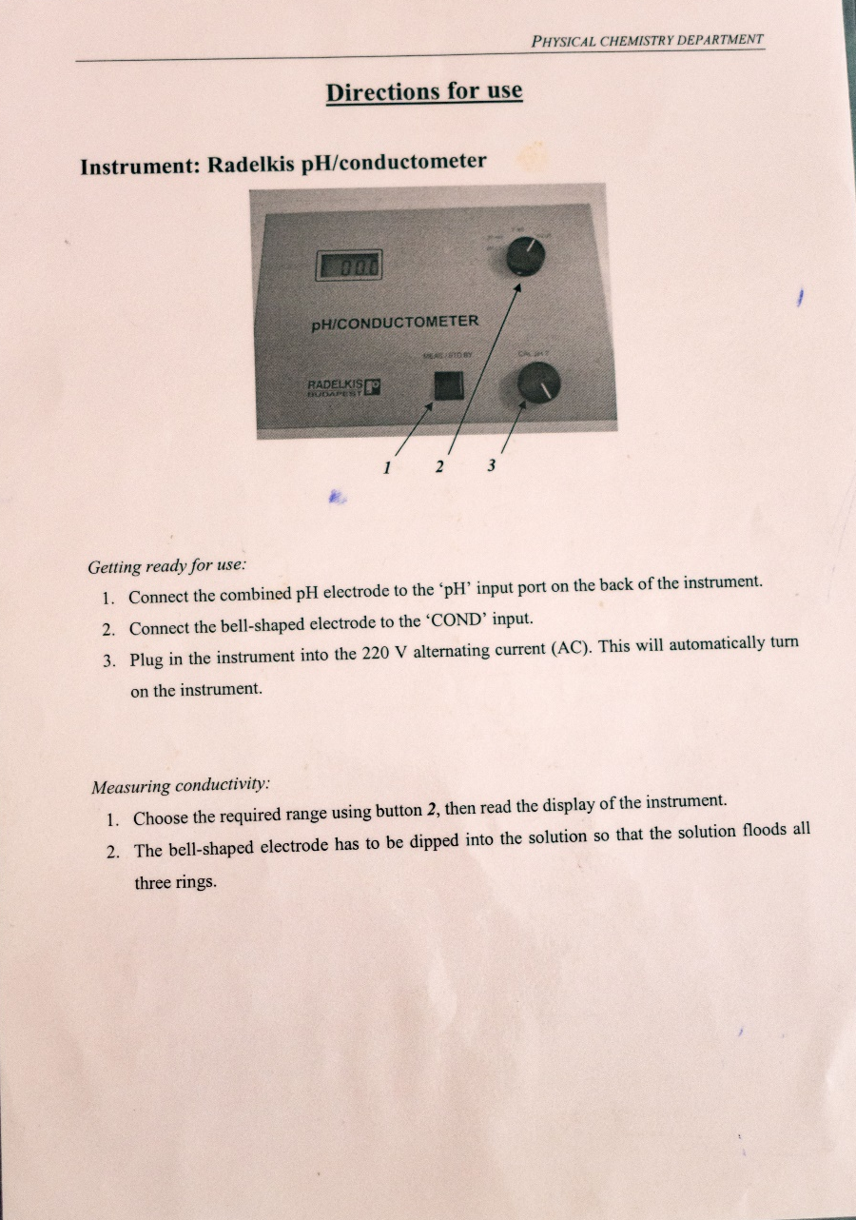
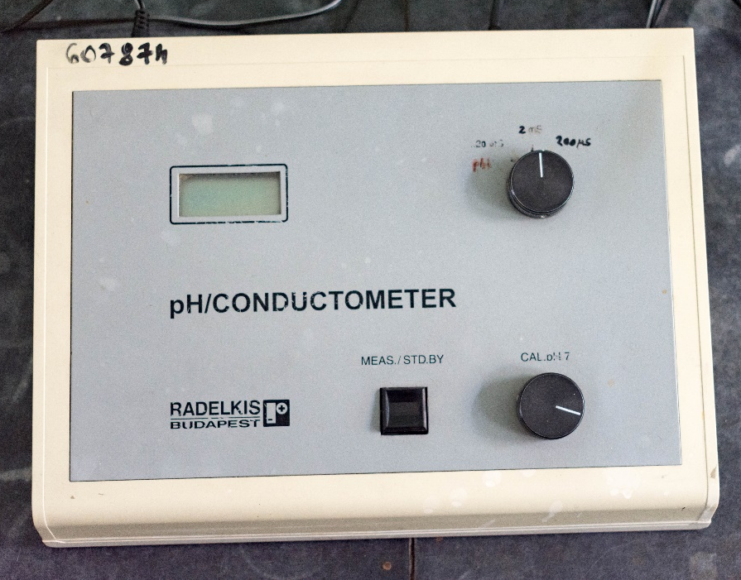
Used conductometers and descriptions
I.

Slide 6
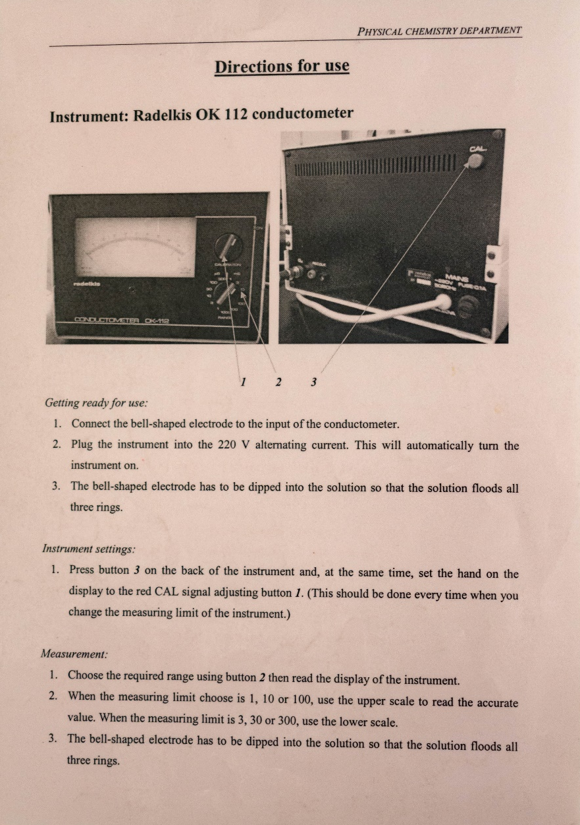
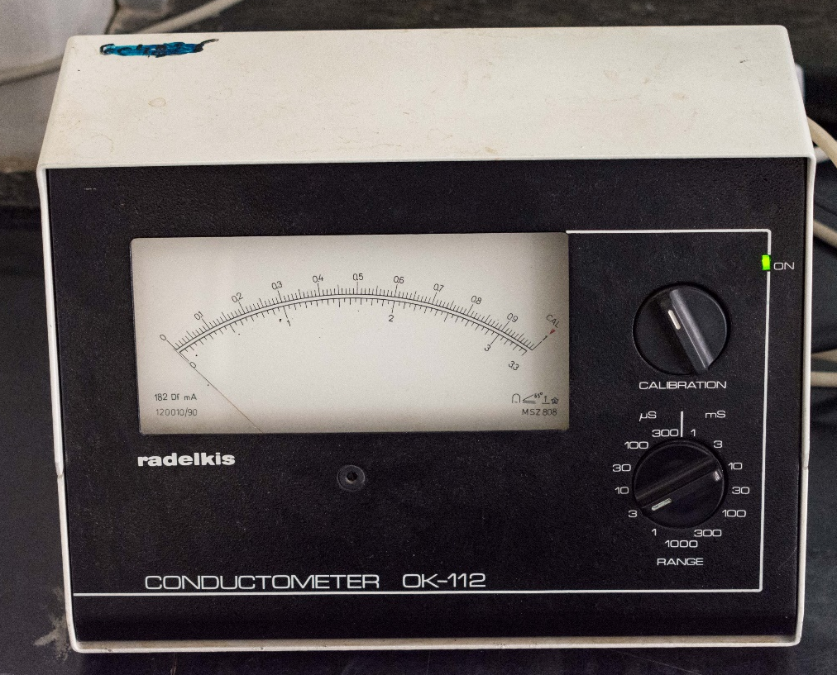
Used conductometers and descriptions
II.

Slide 7
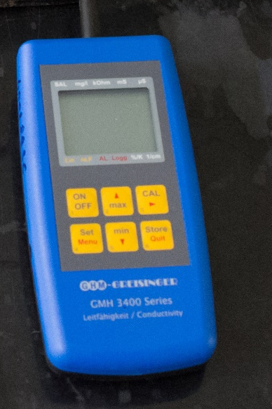
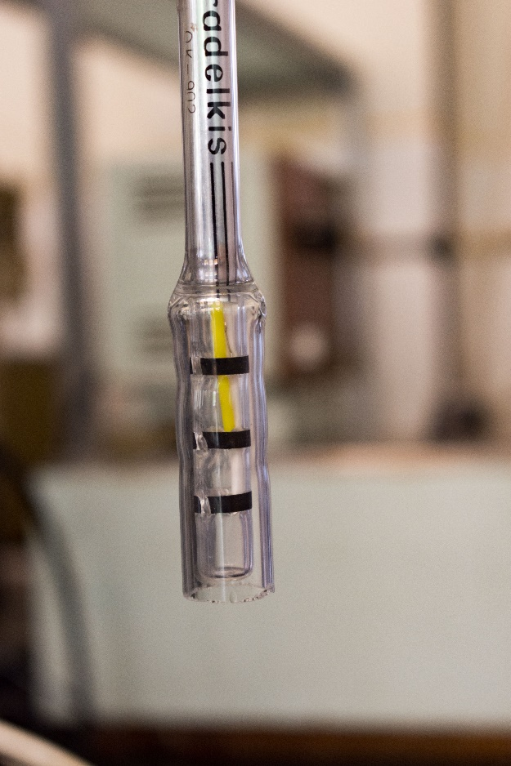
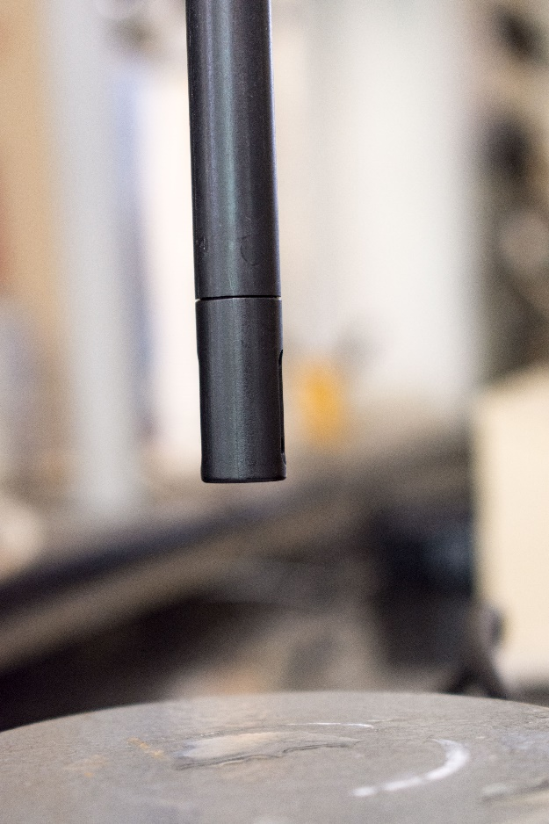
Used conductometers and descriptions, electrodes
III.

Slide 8
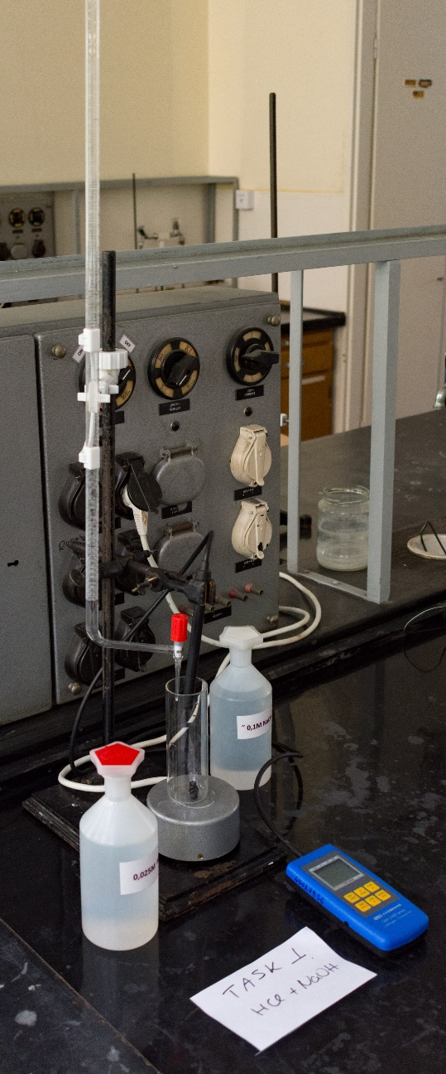
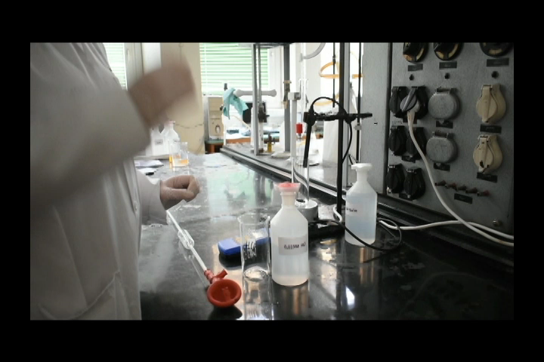
HCl + NaOH measurement procedure, calculation
I.
1. system assembly
set up burette,
connect electrode to the conductometer,
place a magnetic stir bar in the measuring cell
2. pipette exactly 50.00 mL of 0.0025 M HCl solution into the reaction vessel as described

Slide 9
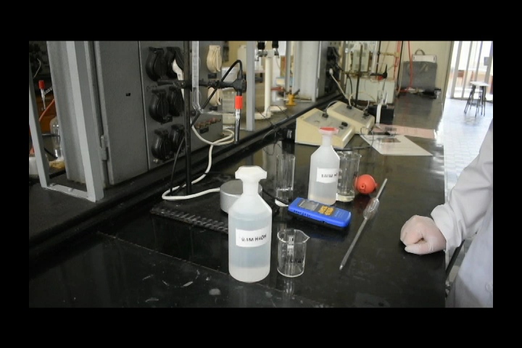
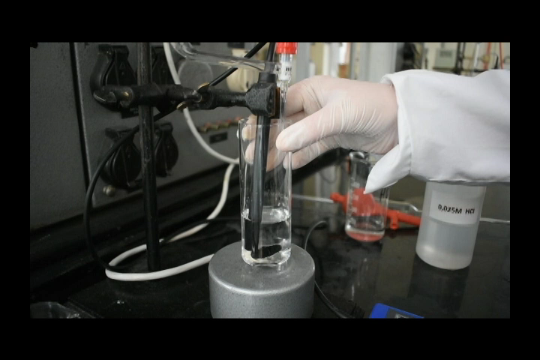
HCl + NaOH measurement procedure, calculation
II.
II.
3. fill the burette with ~ 0.1 M NaOH solution up to the mark
4. measure the conductance while stirring without adding NaOH to the system

Slide 10
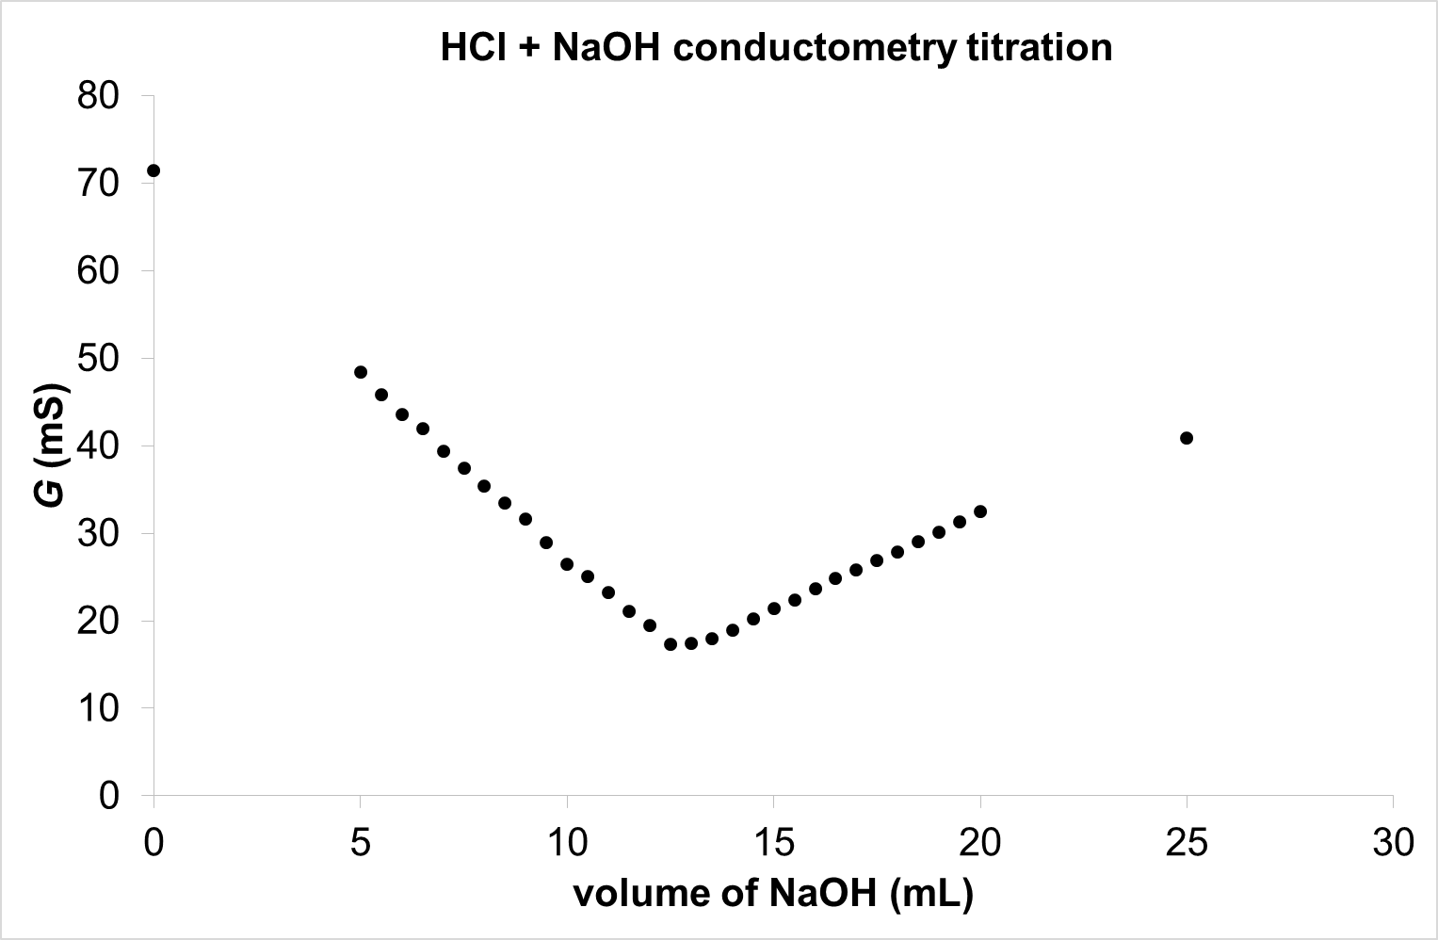
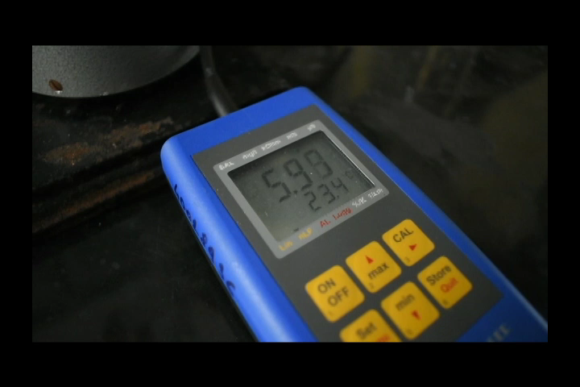
HCl + NaOH measurement procedure, calculation
III.
5.
As described, firstly 5 mL of NaOH (from the burette) is added to the HCl solution, the conductance value changes immediately (video).
Then, titrate with 0.5 mL portions and record the conductance-added volume data pairs.
The values ​​obtained during a measurement are shown in the figure above.

Slide 11
HCl + NaOH measurement procedure, calculation
IV.
6. calculation
the determined equivalence point is used (12.5 mL in the figure)
we know the exact concentration (0.0025 M) and volume (50.0 mL) of HCl, calculate its molar amount
this is equal to the molar amount of NaOH
thus, the exact concentration of NaOH can be calculated

Slide 12
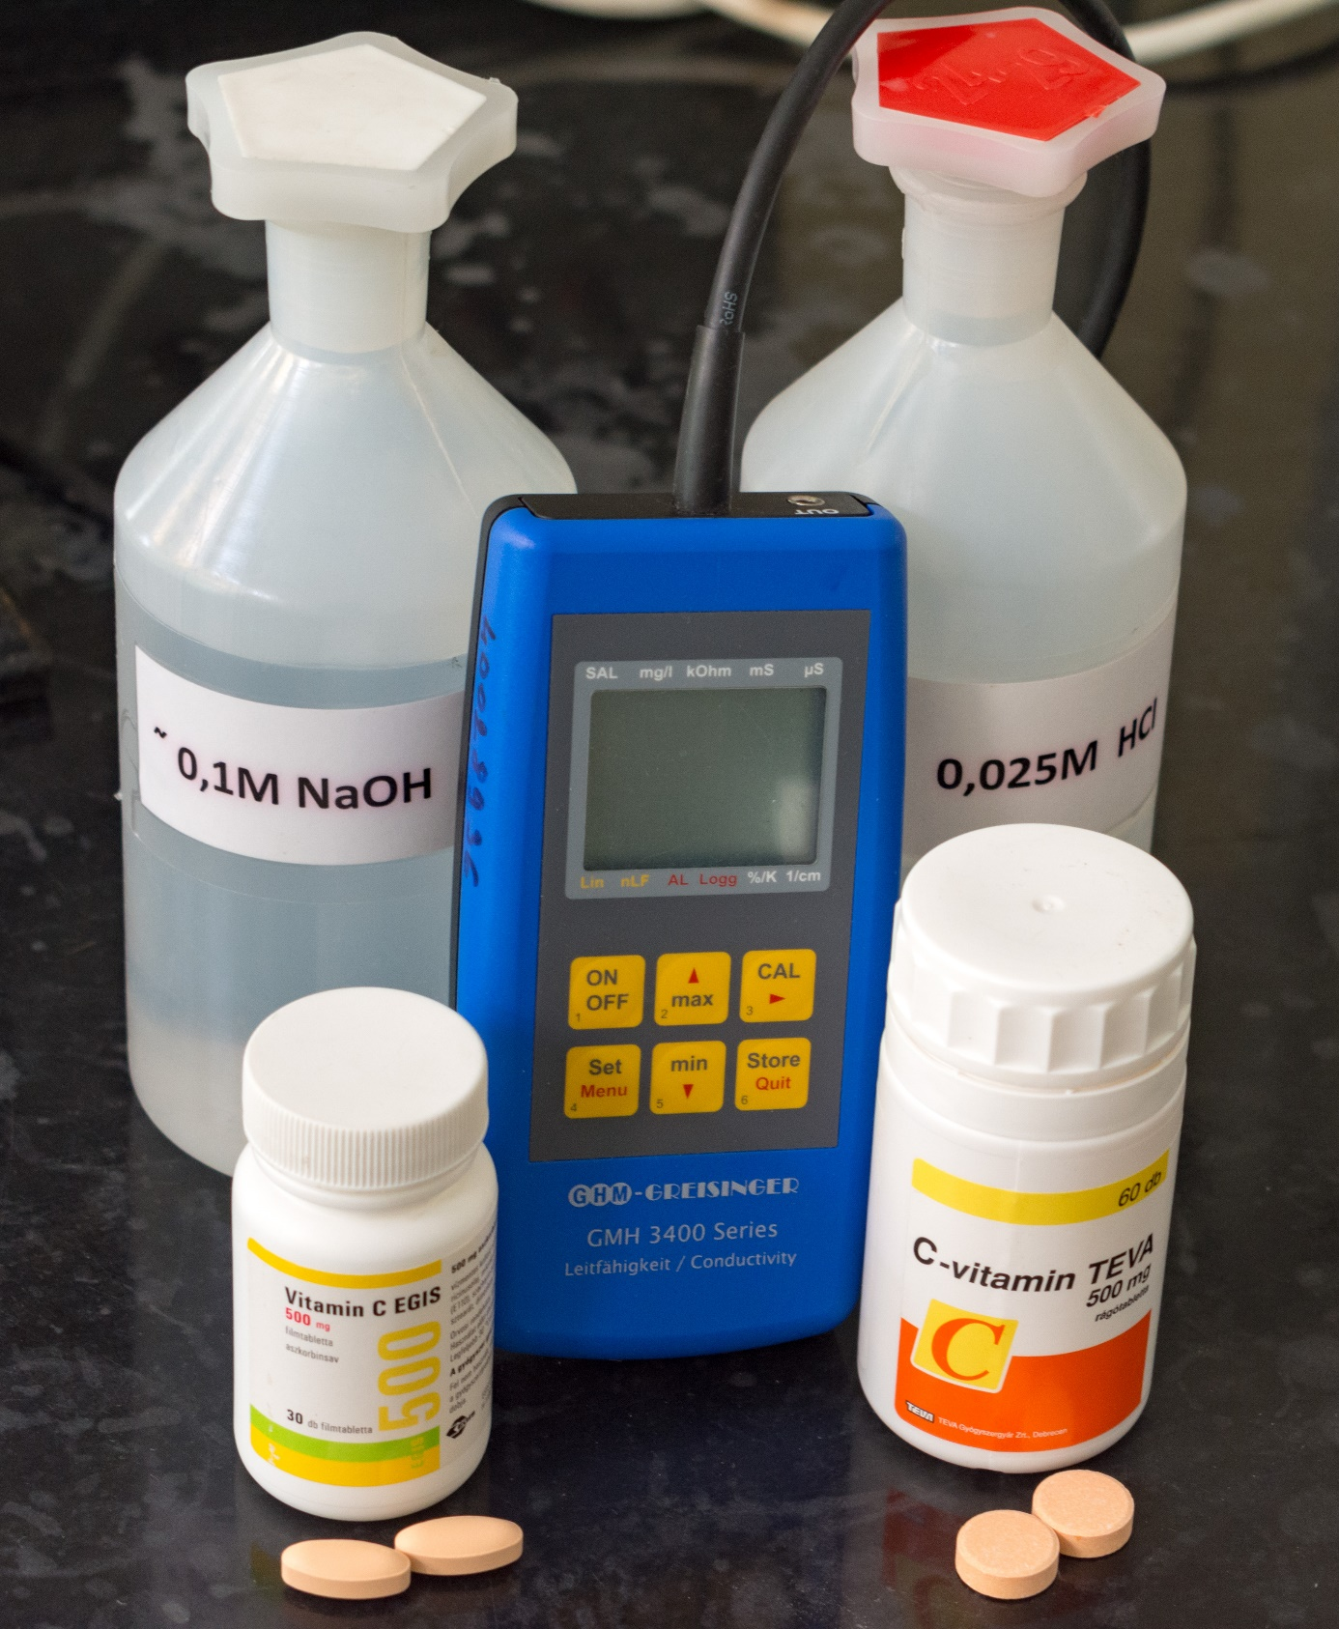
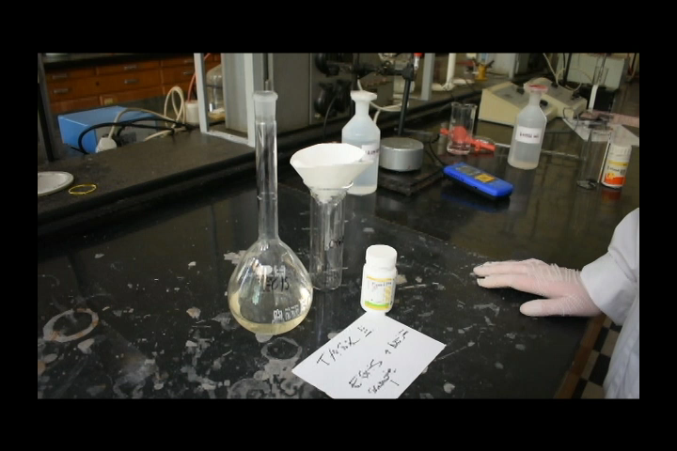
EGIS + NaOH measurement procedure, calculation
I.
1. Preparation of vitamin C (EGIS) stock solution
The concentration of the stock solution should be 4 mg / mL. Each capsule contains 500 mg of active substance and the volume of the stock solution is 500 mL. How many capsules should be dissolved? 4.
The capsule was dissolved in 0.0025 M HCl.
As there is an insoluble precipitate (TiO₂) in the solution, we filter the solution.
The stock solution already prepared in the video is filtered again. Measurements were already taken from it, therefore, the flask was not filled totally up to the mark.

Slide 13
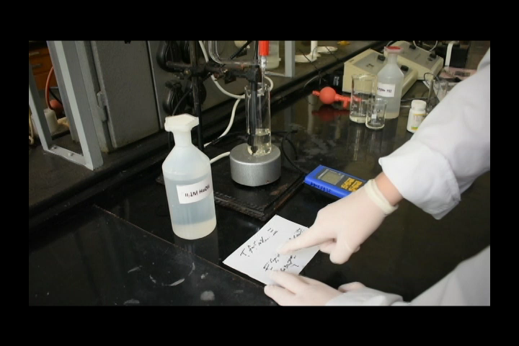
EGIS + NaOH measurement procedure, calculation
II.
2. Pipette 20 mL of the filtered stock solution into a 50 mL volumetric flask and fill it totally up to the mark with 0.0025 M HCl. Shake and pour completely into the reaction vessel.
3. Measure the conductance without the addition of NaOH while stirring, according to the first measurement. Then add 5 mL and then 0.5 mL portions of NaOH solution, and record the conductance value at each point.

Slide 14
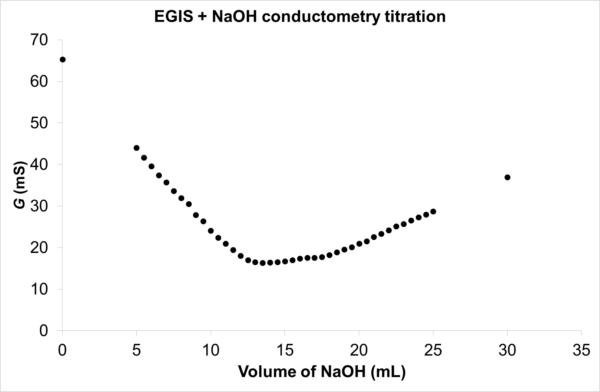
EGIS + NaOH measurement procedure, calculation
III.
During the evaluation, we select the „straight line” (V1, V2) where the conductance barely changes. ΔV = V2-V1 gives the volume of NaOH.
From the first task we know the exact concentration of NaOH, with the help of this figure its volume is also known, so its molar amount can be calculated. This equals to the molar amount of ascorbic acid.
The mass of ascorbic acid can be calculated with the molecular weight. Attention! This is in the 50 mL diluted sample not in the whole stock solution.
7. Calculate the molar amount of ascorbic acid in the total 500 mL stock solution and then indicate how much was in each tablet. Compare it with the literature 500 mg/tablet value. Also calculate the percentage difference.
V1
V2

Slide 15
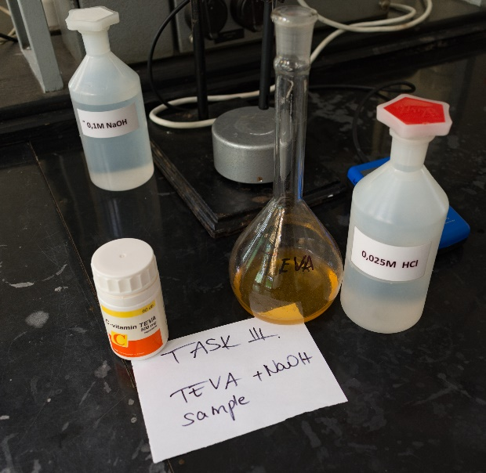
TEVA + NaOH measurement procedure, calculation
I.
1. Preparation of vitamin C (TEVA) stock solution
The concentration of the stock solution should be 4 mg/mL. Each capsule contains 500 mg of active substance and the volume of the stock solution is 500 mL. How many capsules should be dissolved? 4.
The capsule was dissolved in 0.0025 M HCl.
2. Pipette exactly 50 mL of the stock solution into the reaction vessel.
3. Measure the conductance values without the addition of NaOH while stirring, according to the first measurement. Then add 5 mL and then 0.5 mL portions of NaOH solution, recording the conductance value at each point.

Slide 16
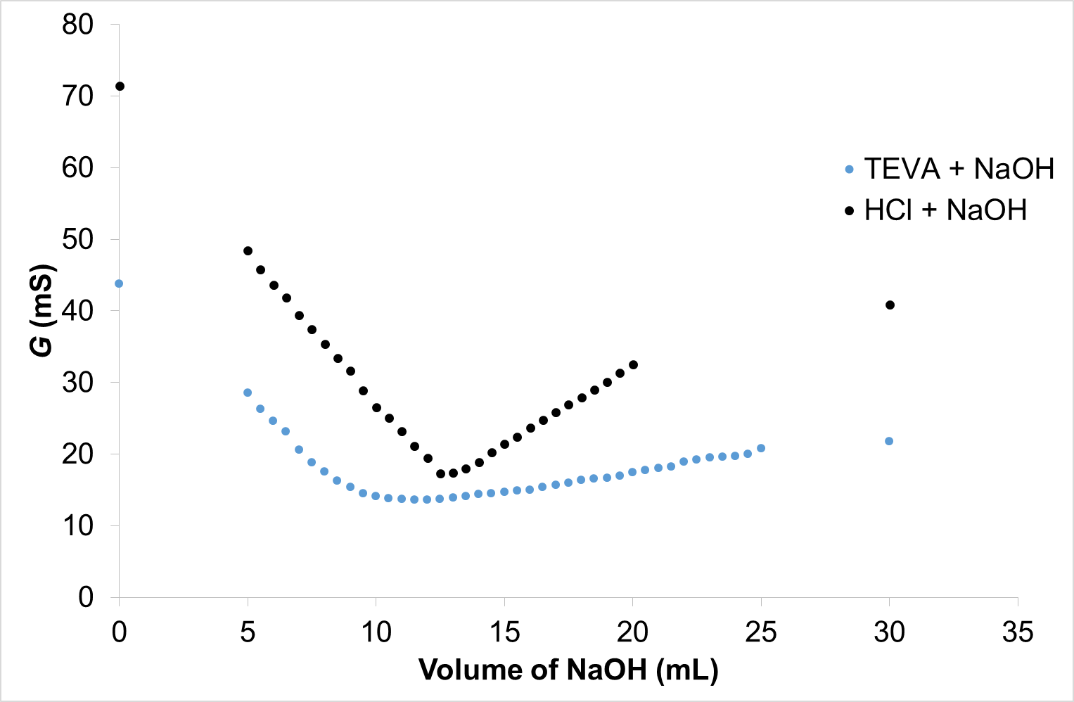
TEVA + NaOH measurement procedure, calculation
II.
4. The TEVA capsule contains 371 mg of Na-ascorbate and 220 mg of ascorbic acid. In the stomach, Na ascorbate is converted to ascorbic acid, which is why it is written that there is 500 mg of ascorbic acid in one capsule.
5. The first measurement (HCl + NaOH) is also required for this calculation. Based on VO-V1 Na-ascorbate, and based on V2-VO the mass of ascorbic acid can be calculated.
Na-ascorbate
ascorbic acid
6. Calculation is similar as previously: based on these volumes and the concentration of NaOH, its molar amount can be calculated, which equals the molar amount of either Na-ascorbate or ascorbic acid in the studied range.
V0
V1
V2

Slide 17
TEVA + NaOH measurement procedure, calculation
III.
7. Knowing the molar amounts, the molecular weight can be used to calculate the weight. Caution: this is the weight of our analytes (Na ascorbate and ascorbic acid) in our sample, but we need to calculate how much analyte was in the stock solution (500 ml) and in one capsule.
8. Here again, we calculate the percentage difference in both cases (Na-ascorbate and ascorbic acid), we also compare the total vitamin C content and calculate the percentage difference, as well.
Good luck with the short test, calculations and lab note

Slide 18
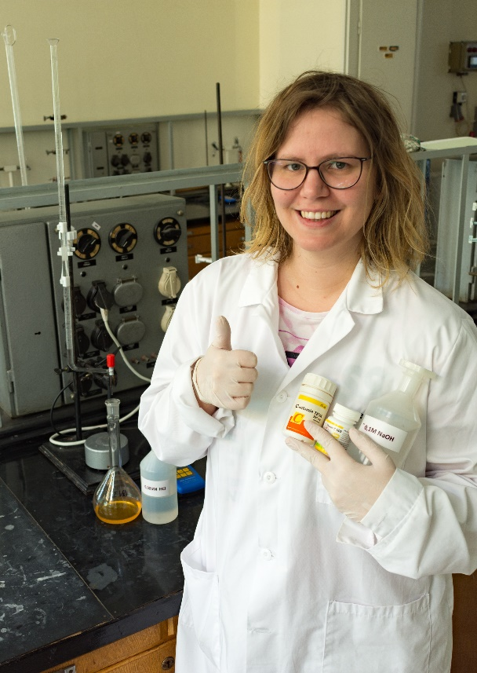
Important informations
short test time: 04.22. Wednesday 16:00
lab note submission deadline: 04.24. Friday 16:00
oral exam time: 04.24. Friday 16:00-18:00
Availability
e-mail: kiss.virag@science.unideb.hu
skype: akissviragszal
The presentation was prepared by Dr. Virag Kiss
The videos and pictures were recorded by Dr. Adam Kecskemeti
Music used in videos:
Sister Act - Pay Attention https://www.youtube.com/watch?v=gVDFvrqiTMg&list=RDgVDFvrqiTMg&start_radio=1
Kamilka & Pesti Sikk - Így van jól https://www.youtube.com/watch?v=gYtjiNRpiEo
AC/DC - Back In Black https://www.youtube.com/watch?v=pAgnJDJN4VA
Earth, Wind & Fire - Boogie Wonderland https://www.youtube.com/watch?v=god7hAPv8f0
Guns N' Roses - Sweet Child O' Mine https://www.youtube.com/watch?v=1w7OgIMMRc4

